Slide 1

Functions Declarations, Function Expressions and IIFEs
Ways of creating functions, nested functions, IIFEs
JavaScript OOP
Telerik Software Academy
http://academy.telerik.com

Slide 2
Table of Contents
Functions in JavaScript
Function object
Defining Functions
Function declarations
Function expressions
Function constructor
Expression vs. declaration
Function properties
Function methods

Slide 3
Table of Contents (2)
Recursion
Factorial example
Traversing the DOM
Recursion with expressions
Nested functions
Immediately-invoked function expressions

Slide 4


Functions in JavaScript

Slide 5
Functions in JavaScript
Functions are small named snippets of code
Can be invoked using their identifier (name)
Functions can take parameters
Parameters can be of any type
Each function gets two special objects
arguments contains all passed arguments
this contains information about the context
Different depending of the way the function is used
Function can return a result of any type
undefined is returned if no return statement

Slide 6
Functions in JavaScript (2)
Different function usages:
function max (arr) {
var maxValue = arr[0];
for (var i = 1; i < arr.length; i++) {
maxValue = Math.max(maxValue, arr[i]);
}
return maxValue;
}
function printMsg(msg){
console.log(msg);
}

Slide 7

Functions in JavaScript
Live Demo

Slide 8

Function Object

Slide 9
Function Object
Functions are one of the most powerful features in JavaScript
And one of the most important
First-class functions in JavaScript
They can be assigned to variables or properties, passed as arguments and returned by other functions
They have properties of their own
length, caller, name, apply, call
function max(arr){ … }
console.log(max.length); //returns 1
console.log(max.name); //returns "max"
console.log((function(){}).name));

Slide 10
Function Object
Functions are objects and they can be used as objects
Can be passed as arguments to functions
Can be stored in an array
Can be assigned to variable
Can be returned by another function
var arr = [3, 2, 1, 3, 4, 5, 1, 2, 3, 4, 5, 7, 9];
function orderBy(x, y) { return x - y; }
arr.sort(orderBy);
//better to be done using anonymous function
//arr.sort(function(x, y){return x - y;});

Slide 11

Function Object
Live Demo

Slide 12

Defining Functions

Slide 13
Creating Functions
Many ways to create functions:
Function declaration:
function printMsg (msg) {console.log(msg);}
Function expression
var printMsg = function () {console.log(msg);}
With function constructor
var printMsg = new Function("msg",'console.log("msg");');
Since functions are quite special in JavaScript, they are loaded as soon as possible

Slide 14
Function Declaration
Function declarations use the function operator to create a function object
Functions created with declaration are available anywhere in their scope
No matter where they are declared
This allows using a function before it is defined
printMsg("Hello");
function printMsg(msg){
console.log("Message: " + msg);
}

Slide 15

Function Declarations
Live Demo

Slide 16
Function Expression
Function expressions are created using the function literal
They are available where they are defined
And cannot be used beforehand
Can be invoked immediately
The name of function expressions is optional
If the name is missing the function is anonymous
var printMsg = function (msg){
console.log("Message: " + msg);
}
printMsg("Hello");

Slide 17
Function Expression (2)
Function expressions do not need an identifier
It is optional
Still it is better to define it for easier debugging
Otherwise the debuggers show anonymous
Types of function expressions
var printMsg = function (msg){
console.log("Message: " + msg);
}
var printMsg = function printMsg(msg) {
console.log("Message: " + msg);
}
(function(){…});

Slide 18
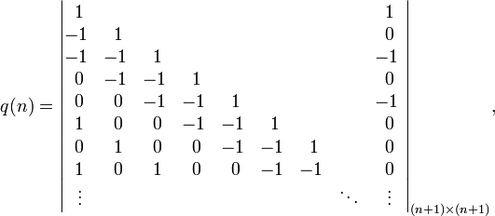
Function Expressions
Live Demo

Slide 19
Function Constructor
Functions created with the Function constructor are similar to expressions
A constructor initializes a function object
Available when reached
The function constructor form is:
Example
Not commonly used
Suitable for dynamically generated code
new Function([optional arguments],body);
var printMsg = new Function("msg","console.log(msg);");
printMsg("Hello!");

Slide 20




Function Constructor
Live Demo

Slide 21
Function Properties
Values
Object
Methods

Slide 22
Function Properties
Each function is an object
Created either with declaration, expression or constructor
Functions have properties:
function.length
The count of parameters the function expects
The arguments object is not counted
function.name
Identifier of the function
Returns an empty string if anonymous

Slide 23
Function Methods

Slide 24
Function Methods
Functions have methods as well
function.toString()
Returns the code of the functions as a string
function.call(obj, args)
Invokes the function with this set to obj and the given args
function.apply(obj, [arg1, arg2, …])
Invokes the function with this set to obj and the arguments are given as an array [arg1, arg2, …]
Basically call and apply do the same
One gets args, the other gets array of args

Slide 25
Call and Apply: Examples
Examples:
Math.max(), Math.min()
//regular use:
max = Math.max(n1, n2, n3);
//with array:
var numbers = […];
max = Math.max.apply (Math, numbers);
min = Math.min.apply (Math, numbers);
Array#slice
function sum(){
var args = [].slice.call(arguments, 0);
//here args is an array
return args.reduce(function(s, n) {
return s + n;
}, 0);
}

Slide 26
Function Methods
Live Demo

Slide 27
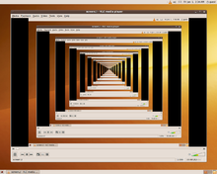
Recursion
Calling functions from themselves

Slide 28
Recursion
Functions can refer to themselves as call to themselves
This is called recursion
Example:
function factorial(n){
if(n === 0){
return 1;
}
return factorial(n-1) * n;
}

Slide 29
Recursion
Functions can refer to themselves as call to themselves
This is called recursion
Example:
A recursion must always have an exit condition!
function factorial(n){
if(n === 0){
return 1;
}
return factorial(n-1) * n;
}

Slide 30
Recursion (2)
Recursion works quite well when:
Traversing data structures
Trees, matrices, graphs, DOM nodes
Generating combinations
Generating sequences
Fibonacci, factorial
Every recursion can be replaced by enough loops, and form the so called iterative solution
Yet, in some cases using recursion is much simpler than using loops

Slide 31
Recursion: Factorial
Using recursion to calculate factorial numbers
Using the formula F(N) = F(N-1) * N
function factorial(n){
if(n === 0){
return 1;
}
return factorial(n-1) * n;
}
console.log(factorial(5)); //120
console.log(factorial(12)); //479001600

Slide 32
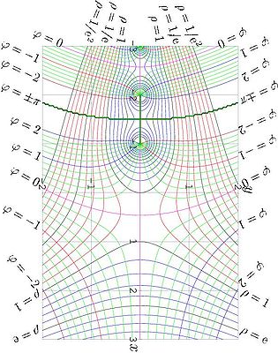
Factorial
Live Demo

Slide 33
Traversing the DOM
Passing a root element
Each element print its tag name and invokes the same function for each of its children
function traverse(element) {
function traverseElement(element, spacing) {
spacing = spacing || " ";
console.log(spacing + element.nodeName);
var len = element.childNodes.length;
for (var i = 0; i < len; i += 1) {
var child = element.childNodes[i];
if (child.nodeType === 1) {
traverseElement(child, spacing + "--");
}
}
console.log(spacing + "/" + element.nodeName);
}
traverseElement(element, "");
}

Slide 34
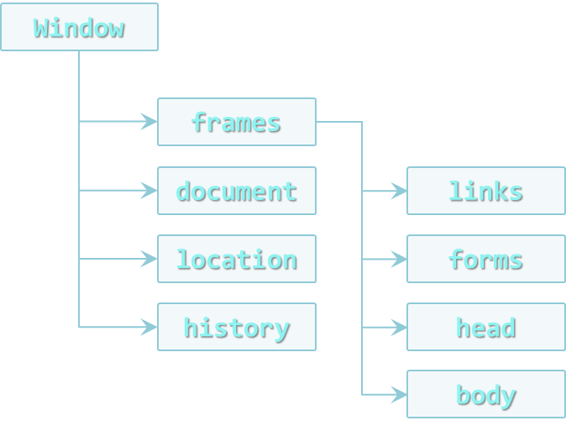
DOM Traversal
Live Demo

Slide 35
Recursion with Function Expression
Recursion is simple enough with function declarations
But not so easy with function expressions
var fact = function (n) {
if (n === 0) {
return 1;
}
return n * fact (n - 1);
};

Slide 36

Recursion with Function Expression
Recursion is simple enough with function declarations
But not so easy with function expressions
var fact = function (n) {
if (n === 0) {
return 1;
}
return n * fact (n - 1);
};
fact(5);
Logs 120

Slide 37
Recursion with Function Expression
Recursion is simple enough with function declarations
But not so easy with function expressions
var fact = function (n) {
if (n === 0) {
return 1;
}
return n * fact (n - 1);
};
fact(5);
var f = fact;
f(5);
Assign the function to a variable
Still logs 120

Slide 38

Recursion with Function Expression
Recursion is simple enough with function declarations
But not so easy with function expressions
var fact = function (n) {
if (n === 0) {
return 1;
}
return n * fact (n - 1);
};
fact(5);
var f = fact;
f(5);
fact = 5;
f(5);
Assign a number value to the original function
Throws TypeError (Number is not a function)

Slide 39
Buggy Recursion with Function Expressions
Live Demo

Slide 40
Recursion with Function Expression (2)
The previous example can be solved by giving an identifier to the function expression
Only the function itself can use this identifier
var factorial = function factorial(n) {
if (n == 1) {
return 1;
}
return n * factorial (n - 1);
//or use arguments.callee
};
var factorial2 = factorial;
factorial = 5;
console.log(factorial2(5)); //logs 120 - correct

Slide 41
Working Recursion With Function Expressions
Live Demo

Slide 42
Nested Functions
Function in Function in Function, ….

Slide 43
Nested Functions
Functions can be declared everywhere in the JavaScript code
Even inside another function:
funciton x(){
function y() { /* solves international problems */ }
}
Inner functions are available only inside their parent scope
i.e. y() can be called only from inside x()
Remark: every time x() is invoked, a new y() is created!

Slide 44
Immediately Invoked Function Expressions
Functions invoked immediately after they are created

Slide 45
Immediately Invoked Function Expressions
In JavaScript, functions expressions can be invoked immediately after they are defined
Can be anonymous
Create a function scope
Don't pollute the global scope
Handle objects with the same identifier
IIFE must be always an expression
Otherwise the browsers don't know what to do with the declaration

Slide 46
Valid IIFE
Valid IIFEs
var iife = function(){ console.log("invoked!"); }();
(function(){ console.log("invoked!"); }());
(function(){ console.log("invoked!"); })();
!function(){ console.log("invoked!"); }();
true && function(){console.log("invoked!"); }();
1 + function(){console.log("invoked!"); }();
In all cases the browser must be explicitly told that the thing before () is an expression
IIFEs are primary used to create function scope
And prevent naming collisions

Slide 47
Immediately Invoked Function Expressions
Live Demo

Slide 48
Modules
A module is the result that is returned from an IIFE
Allows hidden data
Evades the polluting of the global scope
var getNextId = (function () {
//lastId is available only inside the IIFE
var lastId = 0;
return function () {
return lastId += 1;
}
}());
console.log(getNextId()); //prints 1
console.log(getNextId()); //prints 2
console.log(lastId); //throws ReferenceError

Slide 49
Simple Modules
Live Demo

Slide 50
Functions Declarations, Function Expressions and IIFEs
http://academy.telerik.com

